Slide 1

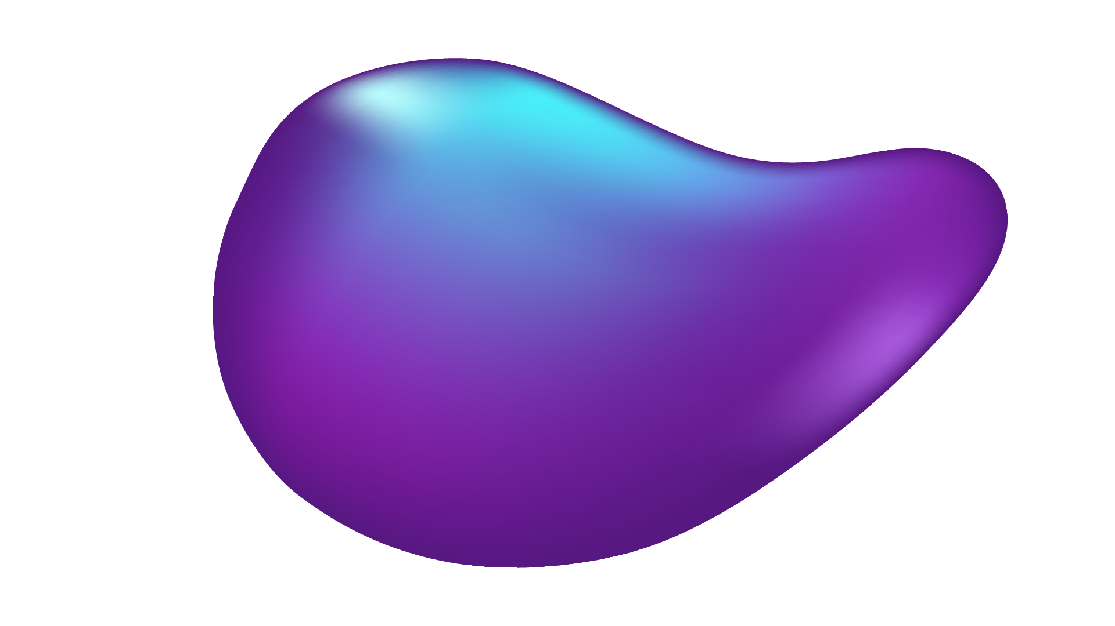

ARTIFICIAL INTELLIGENCE (AI)
Job Matching
By: Kritika Goyal, Nhi Phung, Sarthak Jain, Nathan Young
Notes:
Nhi

Slide 2
Background
Problem Statement
Students need help assessing and improving resume alignment with job postings.
Objective
Automate resume-job matching using AI-powered text similarity methods. Provide interactive career guidance through an AI chatbot.
Significance
Provides insights to improve resumes.
Simplifies the job application process.
Approach
Use methods like TF-IDF, BERT, and Jaccard Similarity.
Build a user-friendly interface with real-time feedback.
Notes:
Nhi

Slide 3
Datasets
RESUMES FROM LIVECAREER.COM
LINKED IN JOB POSTINGS (2023 – 2024)
2400+ Resumes
Containing resumes with structured sections like skills, work experience, and education.
124,000+ job postings
Including fields like job titles, skills, and descriptions.
Notes:
Nhi

Slide 4
Research Questions
How effectively can AI methods (e.g., TF-IDF, BERT, Jaccard Similarity) match resumes to job postings?
Which approach provides the most accurate and meaningful results for automated matching?
Notes:
Nhi

Slide 5
Evaluation Metrics
Similarity Scores: Cosine Similarity, Jaccard Similarity, TF-IDF, Word2Vec, and BERT embeddings.
Top Matches: Identify top 2–3 job postings per resume.
Average Similarity: Evaluate overall alignment between resumes and postings.
Qualitative Analysis: Extract and compare top terms in resumes and job descriptions.
Visualizations: Scatter plots and heatmaps for trend comparison.
Notes:
Nhi

Slide 6
Part 1 – Matching Resumes & Jobs
Notes:
Sarthak

Slide 7
Methodology
Preprocessing
Vectorization
Similarity Calculation
Validation
Notes:
Sarthak

Slide 8
Methods Compared
TF-IDF
BERT
WORD2VEC
JACCARD
Identifies key terms by frequency
Assigns importance to rare words
Captures word meaning contextually
Generates embeddings from text context
Represents words as dense vectors
Preserves semantic relationships in space
Measures overlap between token sets
Compares intersection and union values
Notes:
Sarthak

Slide 9
Validation of Methods
Notes:
Sarthak

Slide 10
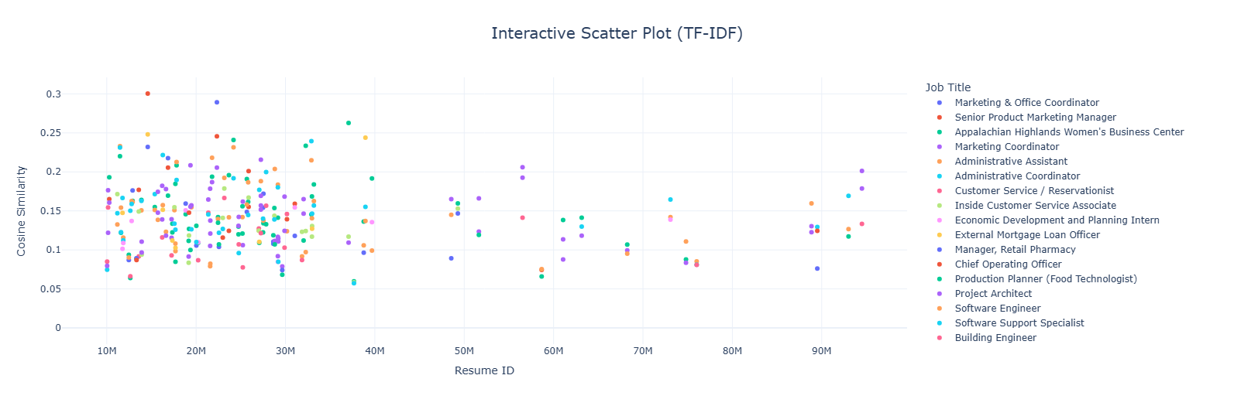
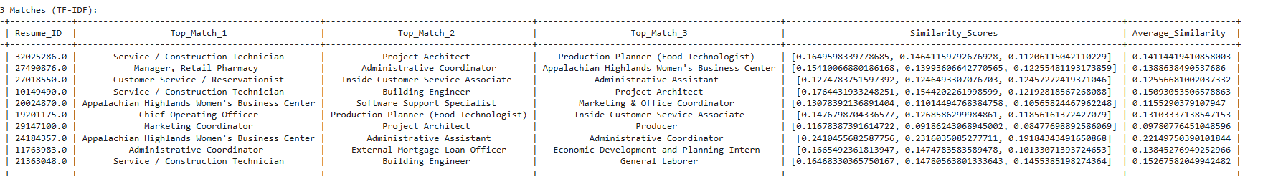
TF-IDF
Simple and effective for resumes
Quick, interpretable, and basic results
Notes:
Sarthak, easy to run, robust for simpler datasets, enough if youre not doing something too complex. More scattered plot, more spread out which says data is not overfit which is a good thing.

Slide 11
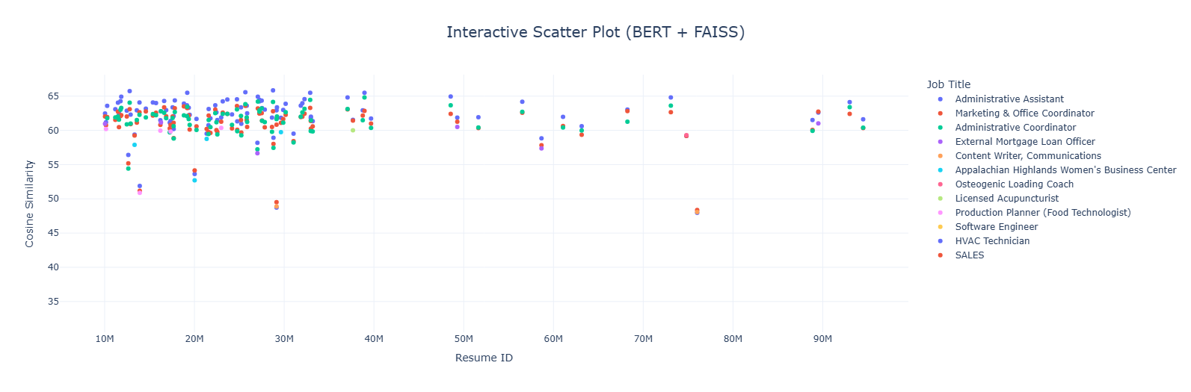
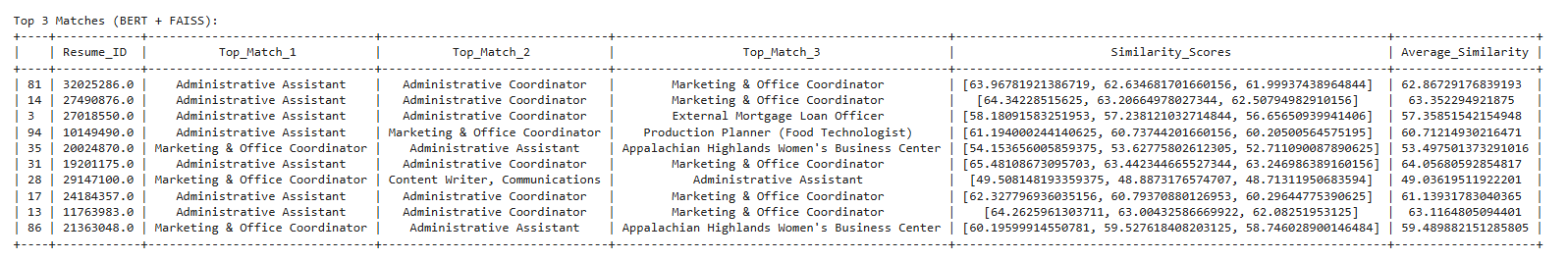
BERT
Captures semantic meaning and relevance
Balances ranking with score spread
Ideal for nuanced tasks like matching
Notes:
Kritika

Slide 12
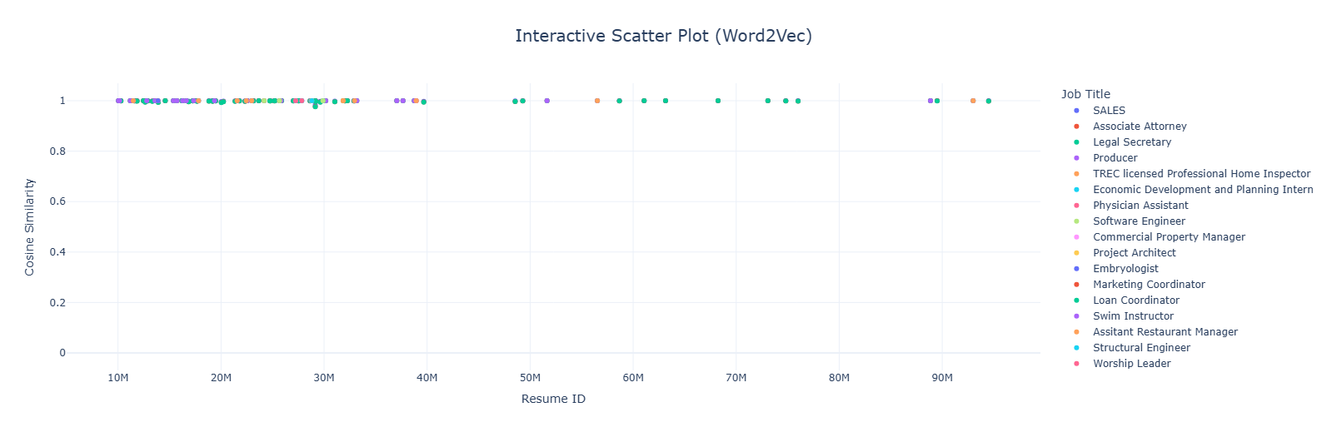
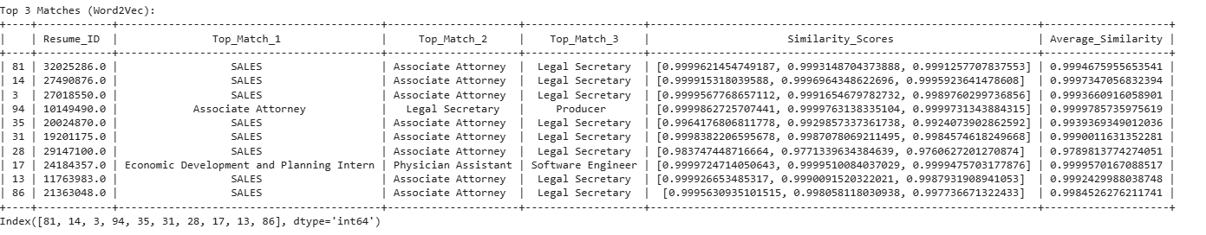
Word2Vec
High scores limit differentiation
Struggles with sensitivity in matches
Risk of overfitting resume similarities
Notes:
Nate
The Word2Vec Method

Slide 13
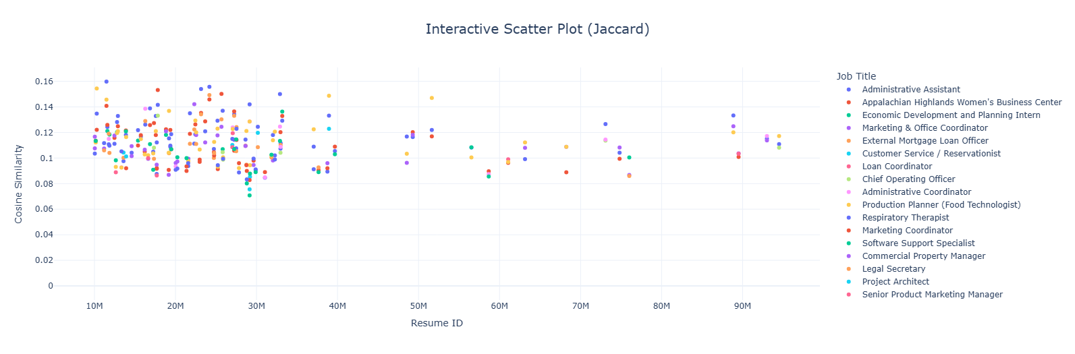
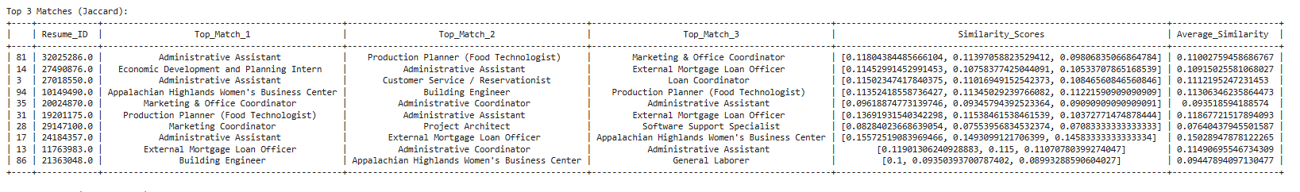
Jaccard
Limited differentiation in scoring
Heavily reliant on token overlap
Weak in nuanced semantic tasks
Notes:
Nhi

Slide 14
Part 2 - Chatbot Web Application
Notes:
Kritika

Slide 15

Career Advisor Chatbot with NLP
Data Preparation
Tokenization
Dataset Splitting
Model Fine-Tuning
Saving the Model
Gradio Deployment
EleutherAI/gpt-neo-125M
Hugging Face Trainer: Fine Tuning
To a local directory
Notes:
Kritika
Data Preparation
Tokenization
Dataset Splitting
Model Fine-Tuning:
Base Model: EleutherAI/gpt-neo-125M
Used Hugging Face Trainer for efficient fine-tuning.
Saving the Model:
Saved the fine-tuned model and tokenizer to a local directory
Deployment with Gradio

Slide 16
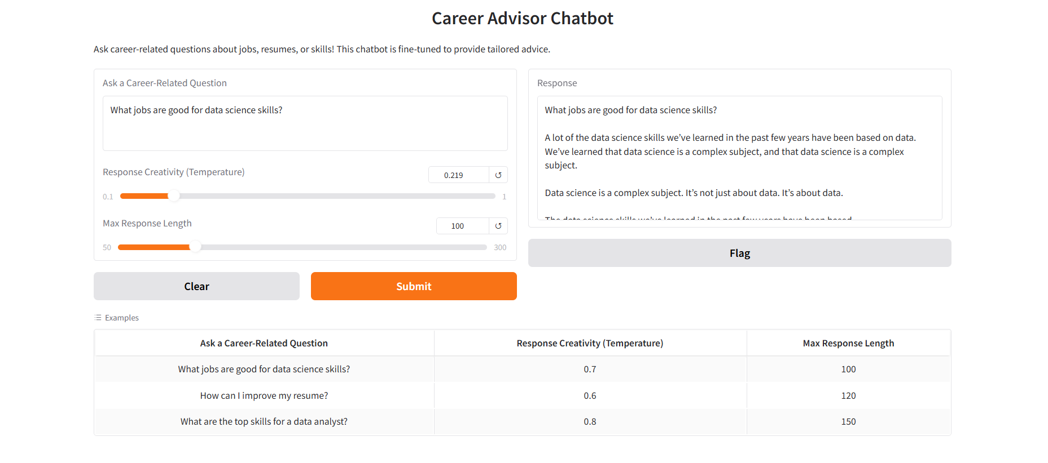
Chat Bot Interface
Notes:
Kritika

Slide 17
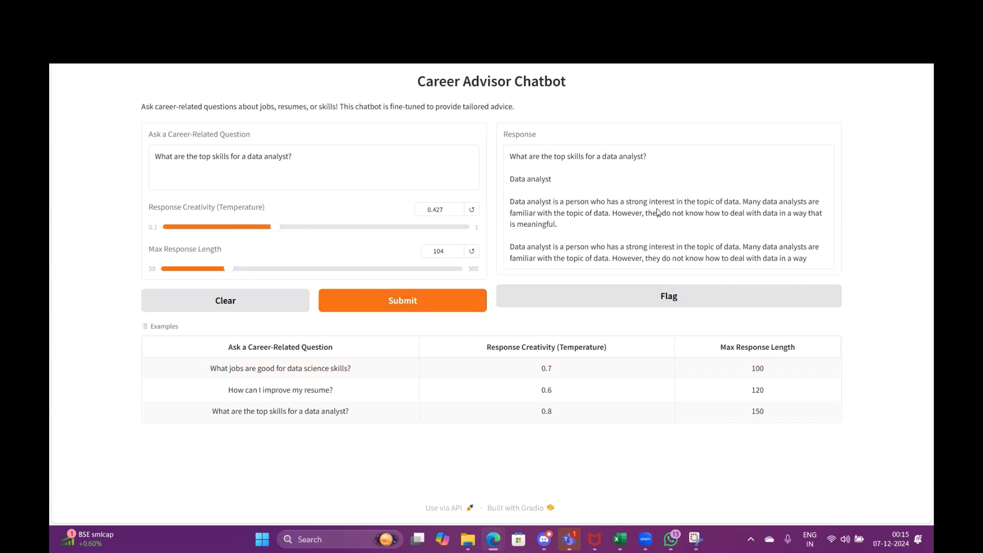
Chat Bot Demo
Notes:
Kritika

Slide 18
Risks
Bias in Algorithm
Pretrained models such as BERT may reflect biases present in training data
Risk of favoring specific demographics or excluding non-traditional resumes
Over-Reliance on Keywords
TF-IDF and Jaccard Similarity heavily depend on matching exact words
Context Misinterpretation
Difficulty understanding nuances like soft skills or transferable experience
False Positives and Negatives
Matching algorithms may flag irrelevant resumes as a match (false positives) or overlook qualified candidates (false negatives)
Notes:
Nate

Slide 19
Mitigating Risks / Fall Backs
Human Oversight!
Bias in Algorithm
Implement fairness audits to identify and mitigate bias in AI outputs
Tools like IBM AI Fairness 360
Over-Reliance on Keywords
Expand pre-trained embeddings to understand synonyms and related concepts such as software engineer and developer
Context Misinterpretation
We can tune models on data specific to the target industry for better contextual understanding
False Positives and Negatives
We can tune our threshold similarity scores to reduce irrelevant matches
Notes:
Nate

Slide 20
Literature
Fillable resume matching systems have been around since the 1970s but their efficacy has been challenged. Many applicant variables such as demographic information aren't included in early models. Our tolerance for algorithmic mistakes should be lower than human error. - (DeLaCruz et all)
The earliest approaches for resume matching dependent on machine learning were relatively simple and relied on basic string matching, keyword extraction, and statistical methods but struggled with semantics much more than modern programs. - (Bocharova and Malakhov)
Notes:
Nathan
There is a wealth of research papers about this topic. Most of it about proposing different methodologies as improvements on current approaches.

Slide 21
Existing Research
Resume Matching Method | Traditional Methods (TF-IDF, Jaccard Similarity) | Hybrid Methods (Combined) | Deep Learning Models (BERT)
Strengths | Simplicity, speed, easy to implement | Captures semantic relationships and contextual understanding | Balances efficiency and accuracy
Weaknesses | Limited semantic understanding, keyword dependence | Computationally expensive, risk of overfitting | Challenging integration
Notes:
Nate

Slide 22

Conclusion
TF-IDF
BERT
WORD2VEC
JACCARD
Notes:
All/Nate

Slide 23
Sources
Seba Susan, Muskan Sharma, Gargi Choudhary. "Uniqueness Meets Semantics: A Novel Semantically Meaningful Bag-of-Words Approach for Matching Resumes to Job Profiles." Inteligencia Artificial, vol. 27, no. 74, 2024, pp. 117–132.
Shakti Kinger, Divija Kinger, Shivam Thakkar, Devashish Bhake. "Towards Smarter Hiring: Resume Parsing and Ranking with YOLOv5 and DistilBERT." Multimedia Tools and Applications, vol. 83, no. 35, 2024, pp. 82069–82087.
Sebastien Delecraz, Loukman Eltarr, Martin Becuwe, Henri Bouxin, Nicolas Boutin, Olivier Oullier. "Responsible Artificial Intelligence in Human Resources Technology: An Innovative Inclusive and Fair by Design Matching Algorithm for Job Recruitment Purposes." Journal of Responsible Technology, vol. 11, 2022, article no. 100041. ISSN 2666-6596. https://doi.org/10.1016/j.jrt.2022.100041. (https://www.sciencedirect.com/science/article/pii/S266665962200018X)
Maiia Y. Bocharova, Eugene V. Malakhov. "CapStyleBERT: Incorporating Capitalization and Style Information into BERT for Enhanced Resume Parsing." Proceedings of the ICSCA 2024, pp. 1–10.
Madhumita Srivastava, Paul Greaney. "Resume Parsing Across Multiple Job Domains Using a BERT-Based NER Model." Proceedings of the AICS 2023, pp. 1–4.
Notes:
Nathan

Slide 24
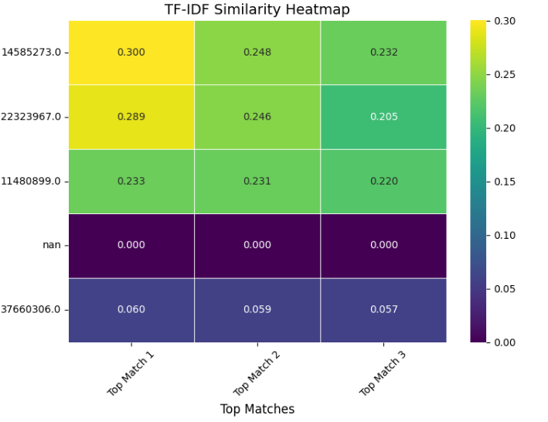
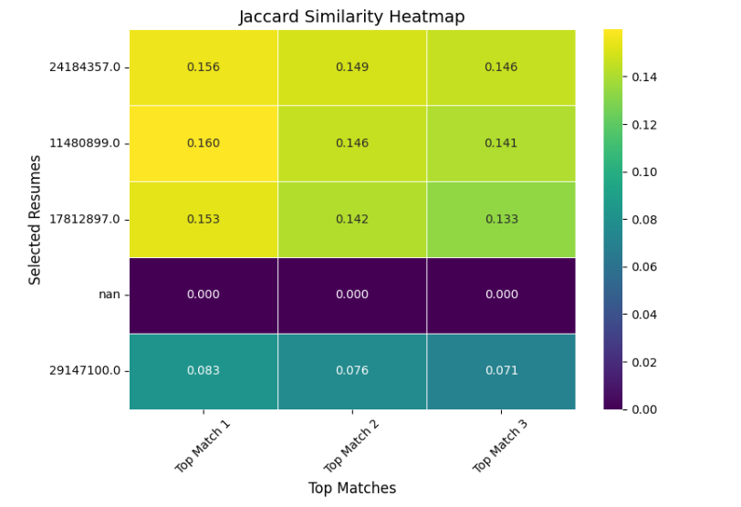
Appendix

Slide 25
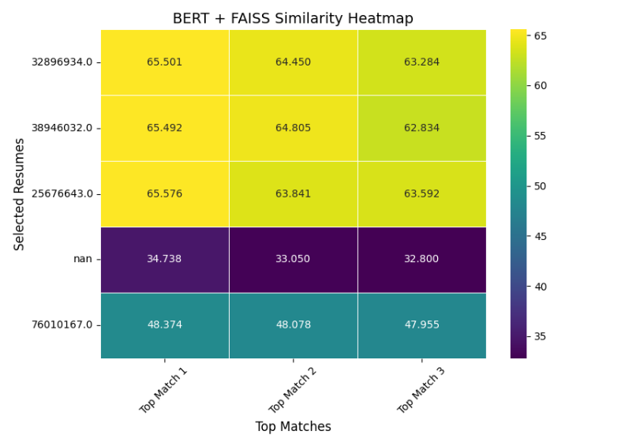
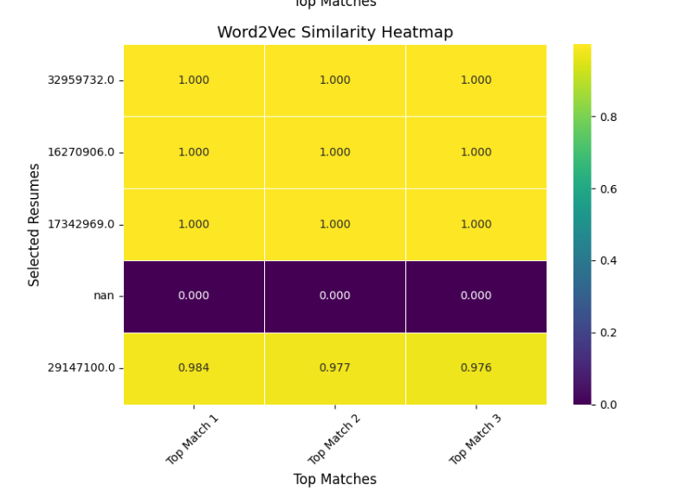
Appendix

